Slide 1


Master of Science in Applied Data Science (ADS)
Portfolio Milestone - Project
Sathish Kumar Rajendiran
666555028 (SUID) srajendi@syr.edu

Slide 2
We are what we repeatedly do. Excellence then, is not an act, but a habit. - Aristotle

Slide 3
Overview
In my current role, I own the Data Strategy & Modernization initiatives at Anaplan and deeply involved in working with data scientists, data analysts, data engineers and business owners across various functional groups. In addition, I am responsible for Data Integration, Data Management, Data Security, Data Quality and Overall Governance of data in compliance with regulatory policies. I have also built the data platform on the Cloud leveraging Big Data technologies by integrating data from numerous transactional systems including Anaplan, Salesforce, Splunk, Greenhouse, Adobe Analytics, Workday and ServiceNow. Thus, ensuring a data driven culture for decision makers across various business units.
I am confident that this master’s program in data science would help fine tune my leadership skills, advance my career and abilities to guide, mentor and drive organizations to excel. Hence, I had enrolled with this world-renowned accrediting association. Be authentic, think big, do not compromise, and consistently work towards achieving goals are my core principles that has taken this far.
Learning Objective (but not limited to)
Collect, organize, and manage data, to make data-driven
Understand major practice areas in data science
Identify patterns in data using visualization, statistical analysis, and data mining
Develop actionable insight based on data
Communicate data analytics and findings to people across a broad range of industries
Synthesize and understand data science ethics and privacy
Course Structure
Asynchronous
Recorded videos
Launch Pad/ Simulation Lab exercises
Homework & Diagnostic quizzes
Synchronous
90 minute - Live sessions
Breakout discussions
Presentations & Online Exams

Slide 4
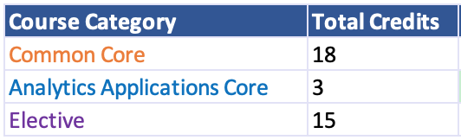
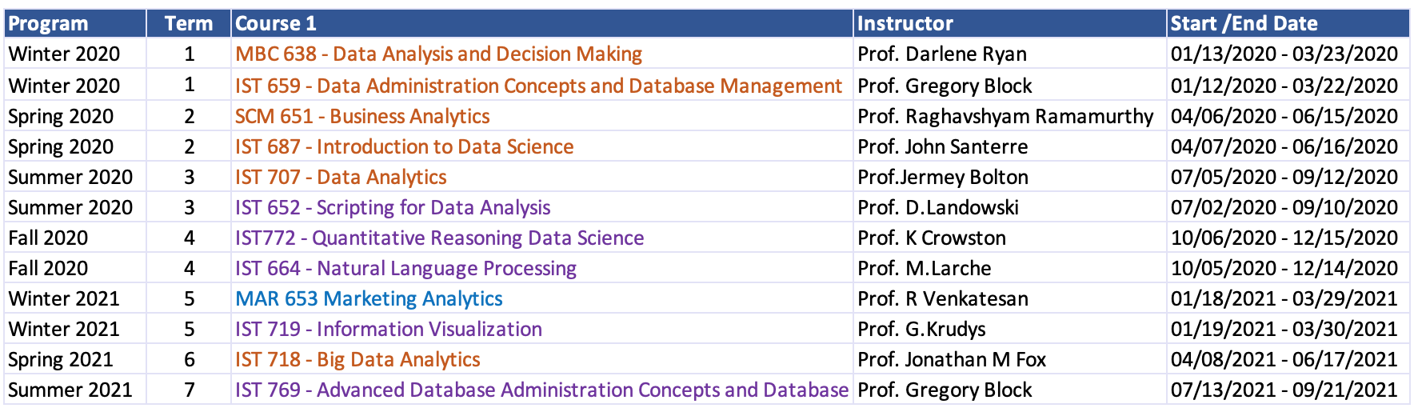
Course Catalog (Total: 36 Credits)

Slide 5
Course Catalog
MBC 638 - Data Analysis and Decision Making
Concepts, principles, and methods to support scientific approach to managerial problem solving and process improvement.
Basic statistical techniques, their appropriateness to situations and assumptions.
IST 659 - Data Administration Concepts and Database Management
Definition, development, and management of databases for information systems.
Data analysis techniques, data modeling, and schema design.
Query languages and search specifications.
Overview of file organization for databases.
Data administration concepts and skills.
SCM 651 - Business Analytics
Business analytics including advanced spreadsheets; relational database and SQL queries.
statistical analysis in R including multi-linear regression, interactions, tests for regression assumptions, logit, probit.
neural networks and dashboards.
IST 687 - Introduction to Data Science
Introduces information professionals to fundamentals about data and the standards, technologies, and methods for organizing, managing, curating, preserving, and using data.
Discusses broader issues relating to data management, quality control and publication of data.
IST 707 - Data Analytics
General overview in data analytics techniques, familiarity with real-world applications, challenges involved in applications, and future directions of the field.
IST 652 - Scripting for Data Analysis
Scripting for the data analysis pipeline. Acquiring, accessing, and transforming data in the forms of structured, semi- structured and unstructured data.

Slide 6
Course Catalog
IST 772 - Quantitative Reasoning Data Science
Classical statistical procedures used in information transfer research.
Emphasis on underlying rationale for each procedure and on criteria for selecting procedures in each research situation.
IST 664 - Natural Language Processing
Linguistic and computational aspect of natural language processing technologies.
Lectures, readings, and projects in the computational techniques required to perform all levels of linguistic processing of text.
MAR 653 - Marketing Analytics
Marketing analytics techniques including discriminant analysis, logit, cluster analysis, factor analysis, and conjoint analysis.
Marketing decision support models such as new product diffusion, test-market, price, and sales promotion decision models.
IST 719 - Information Visualization
A broad introduction to data visualization for information professionals.
Develop a portfolio of resources, demonstrations, recipes, and examples of various data visualization techniques.
IST 718 - Big Data Analytics
A broad introduction to big data analytical and processing tools for information professionals.
Develop a portfolio of theoretical and practical resources for several real-world case studies.
IST 769 - Advanced Database Administration Concepts and Database Management
In-depth analysis of relational and non-relational databases and database management system architecture, building complex database objects, database applications using forms and reports, data warehouses, establishing and implementing database security, and tuning databases for optimum performance.
Lectures, readings and hands-on lab exercises on Big Data platforms such us
Hadoop (HDFS, MapReduce, YARN, Pig, Hive, Hbase, Impala
MongoDB, Redis, Cassandra, Kafka and KSQL

Slide 7
Demonstrate competence and/or mastery of the skills needed
R
Use R to do basic data cleaning and preparation on a wide range of datasets
Use functions to summarize and compare fields
Find missing values
Use subsets or filter data
Retype data into correct format
Identify stories in datasets through exploration
Use R to create appropriate rough plots to identify distributions and relationships in the data
Create rich visual artifacts that communicate data stories
Identify the optimal type of visualization to minimize viewer cognitive overload and maximize image interpretability
Enhance viewer cognition through context cues
Use basic design principles to enhance viewer receptivity and convey meaning
Develop complex categorical data plot, like alluvial, treemap, and river plots in R
Using shape files and geoJSON for map plotting
Using Shiny to create interactive dashboards
Data Mining & Machine Learning
Association Rules, Clustering & Text mining
Classification algorithms including, Logistic regression, Support Vector Machines, naïve Bayes, kNN, Random Forest
Model evaluation metrics

Slide 8
Demonstrate competence and/or mastery of the skills needed
Python
Exploring and transforming Structured data
Arrays, Functions and Categorical summarization
Stacking and Unstacking data
working with pandas dataframe
Semi-structured data
NoSQL databases, PyMongo, JSON Encoder and decoder, Processing Twitter, and Facebook APIs
Unstructured data
Text tokenization, Regular expressions, Finding patterns in Text and Sentiment analysis
Network Structures
Social network analysis, Geolocations on Maps and analyzing Facebook post comments
Visualization
Create powerful visualizations using matplotlib, plotly, seaborn, folium, Wordcloud etc.
Machine Learning
Conventional and Neural network modeling to solve time series, forecasting, regression, image classification and computer vision problems.
Designing deep neural network architectures using CNN, RNN models.
NLP
Linguistic analysis, tokenization, word level semantics, part-of-speech tagging, syntax, semantics, and on up to the discourse level
Sentiment Analysis, information extraction (IE), summarization, and machine translation (MT), information retrieval (IR), question answering (QA), and conversational agents

Slide 9
Demonstrate competence and/or mastery of the skills needed
Relational Databases
Programming
Creating repeatable scripts, user defined functions, procedures, temporal tables, views etc.
Transactions & Concurrency
Ensure database transactions are ACID Compliant
Performance
Analyzing performance of SQL Queries against Big O notation and other performance metrics (index seek vs index scan vs table scans)
Working with Clustered, Non-Clustered, Column-store indexes and Indexed views
Security
Working with permissions and securable
Combining relational and NoSQL concepts in SQL Server
Evaluating any given database system’s architecture fits within the CAP context
Big Data
Hadoop, HDFS, MapReduce, Hbase, Impala, Pig, Hive, Hcatalog and YARN
NoSQL (Document, Key-value, column-family, and streaming)
MongoDB, Redis, Cassandra, Kafka & KSQL
Adobe Illustrator
Poster Creation

Slide 10
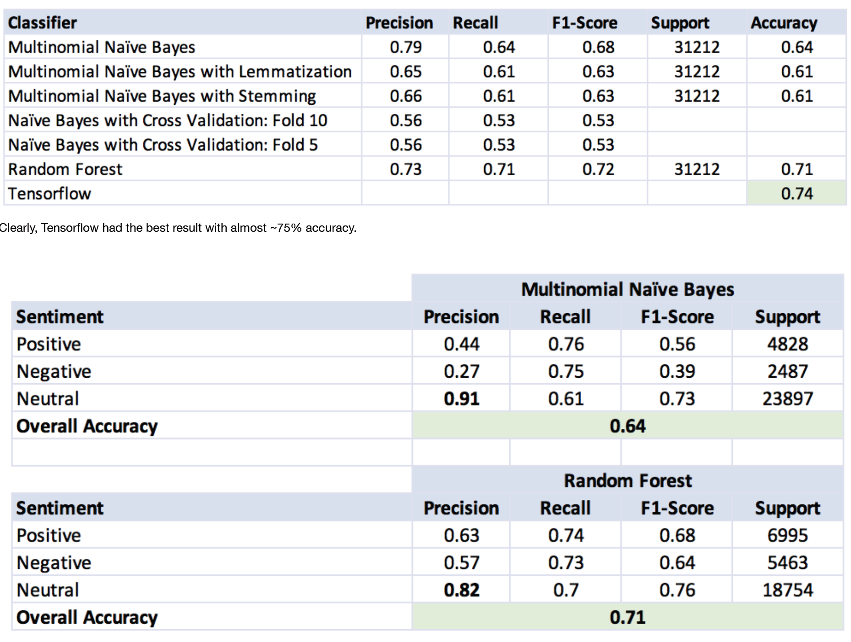
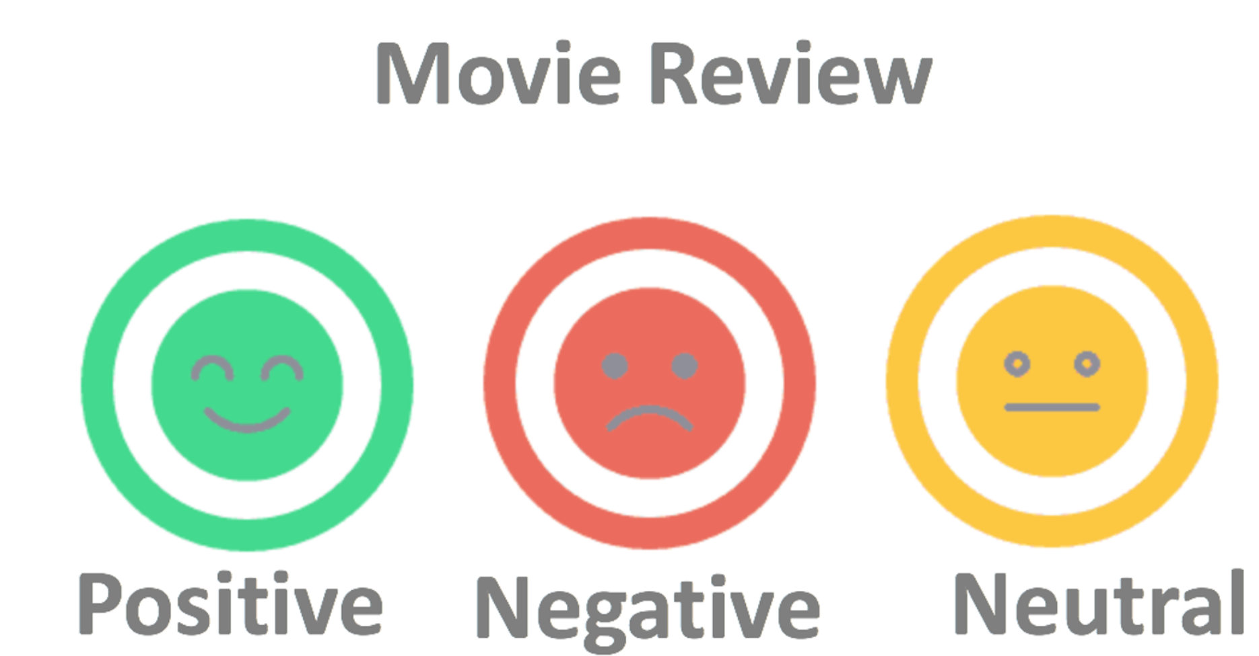
Sentiment Analysis on Movie Reviews
Description
In this project, our objective is to classify the movie reviews as either positive, negative, or neutral from the Kaggle movie reviews dataset using NLTK libraries in Python. It involves, Data collection, Pre-processing, Feature engineering, and experimentation using NLTK classifier algorithms. Our expectation is to try variety of models and preprocessing techniques and choose an optimal combination with accuracy expected in the ranges of 60 to 80%.
Technology
NLTK Python library
Learnings
ZIPf’s Law
The frequency of any word is inversely proportional to its rank in frequency table f r=k (for constant k)
Language models
Regular expressions
Morphology
Lexical, Syntactic, Semantic, Discourse & Pragmatic
Inflection, Derivation, Stemming, Lemmatization
Tokenization
Parts of Speech
Classification techniques
decision tree, rule-based, memory based, instance based, support vector machines, naïve bayes, neural networks and genetic algorithms
Classifier evaluation methods
confusion matrix
precision, recall, F-measures
Issues with imbalanced classes
Sentiment Analysis
Information Retrieval
Source Code
https://github.com/sathish-rajendiran/ist664/tree/main/Final_Project

Slide 11
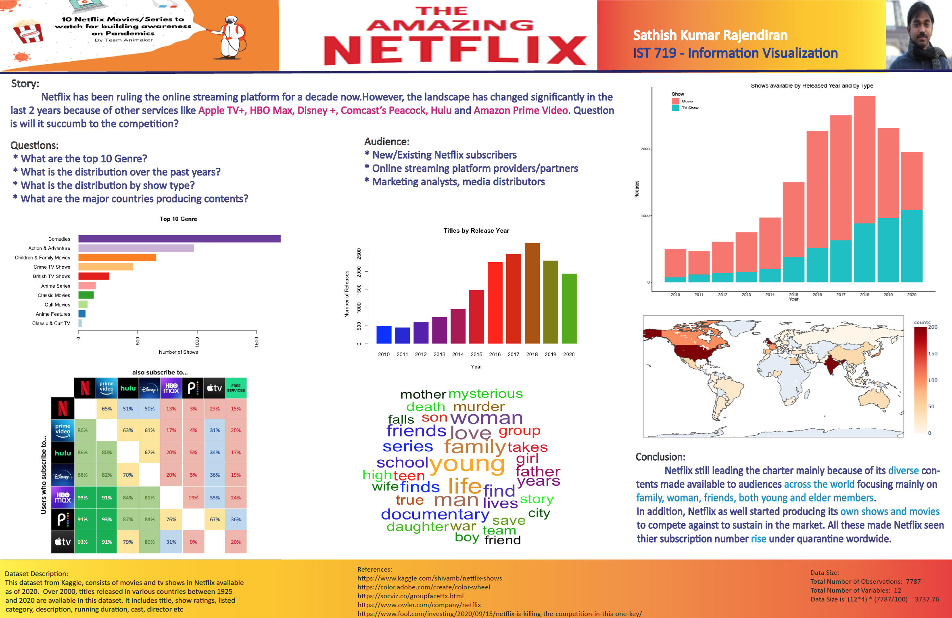
Deliverables/Projects Presented
The Amazing Netflix
Description
Final Poster presentation – prepare and present an information visualization poster from the dataset chosen.
Technology/Tools used:
R, Adobe Illustrator
Learnings
Visually describing a dataset
Modifying plots with Illustrator
Visual Thinking
understanding the difference that makes a difference
Visual encoding
Visual hierarchy
Layouts, Grids & Composition
Rule of Thirds & Golden Ratio
Grammar of Graphics
Poster Critique
Source Code
https://github.com/sathish-rajendiran/ist719/tree/main/Final_Poster

Slide 12
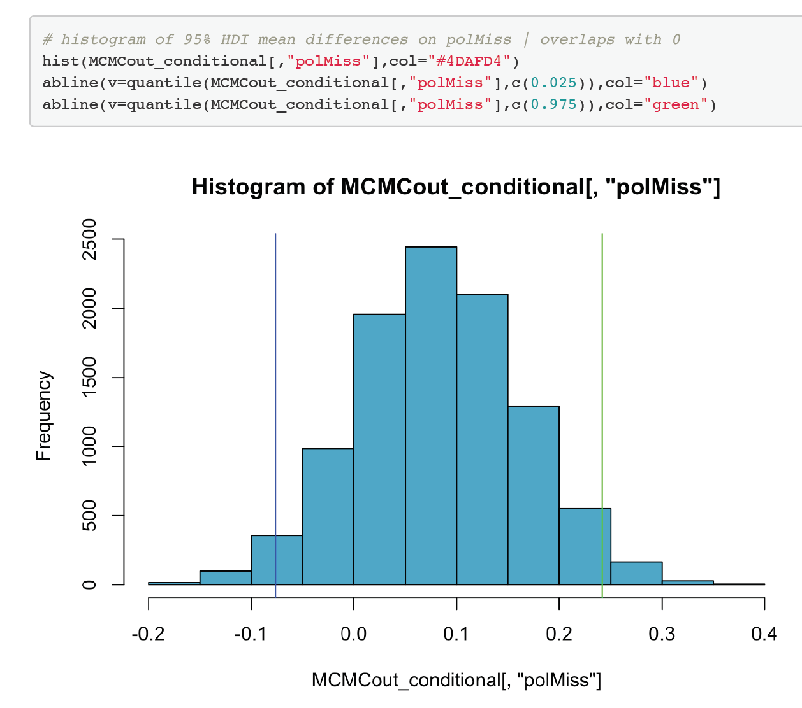
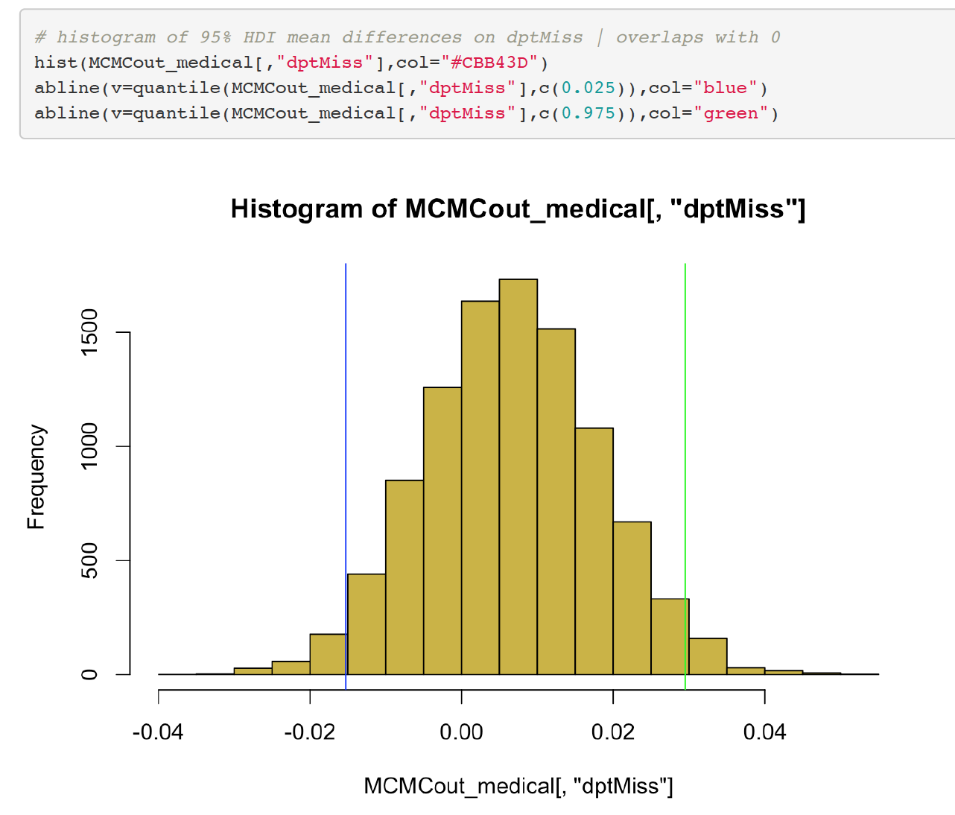
US Vaccines Data
Description
Using US Vaccines and Schools data – perform
exploratory analysis
Statistical analysis
Null Hypothesis Significance test
Confidence Interval
Bayesian distribution high density interval
Predictive Analysis
Build general linear model
Multiple linear regression model
Bayesian Approach to Multiple Regression Analysis
Finally, Comparison to lm (): NHST vs Alternative Hypothesis
Technology
R
Learnings
Explore the characteristics of population using Statistical inferences
Population & Sample
Sampling distribution
Central limit theorem
Law of large numbers
area under the curve & central region
Reasoning with statistical inferences
Confidence interval vs Highest density interval
Null Hypothesis Significance test (NHST)
Bayes theorem
Source Code
https://github.com/sathish-rajendiran/ist772/tree/main/Final_Project

Slide 13
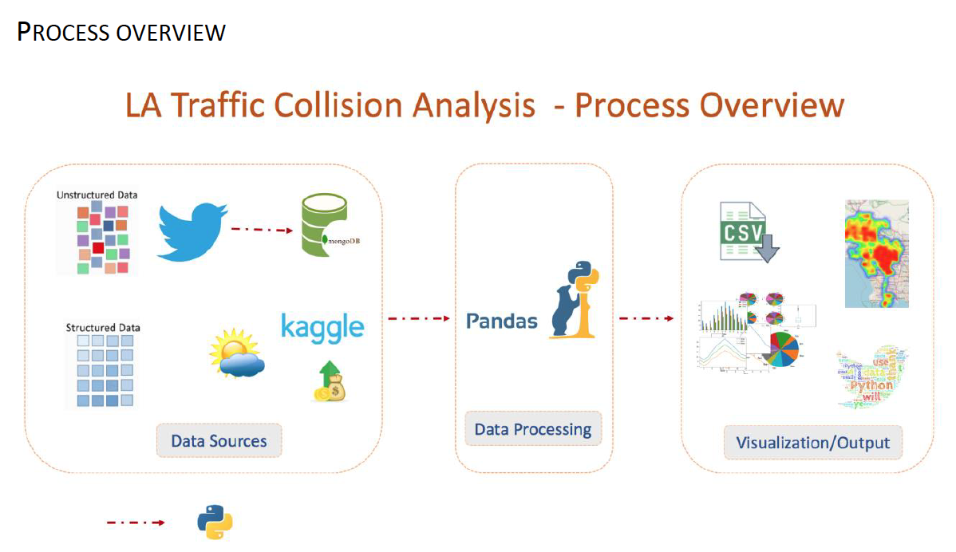
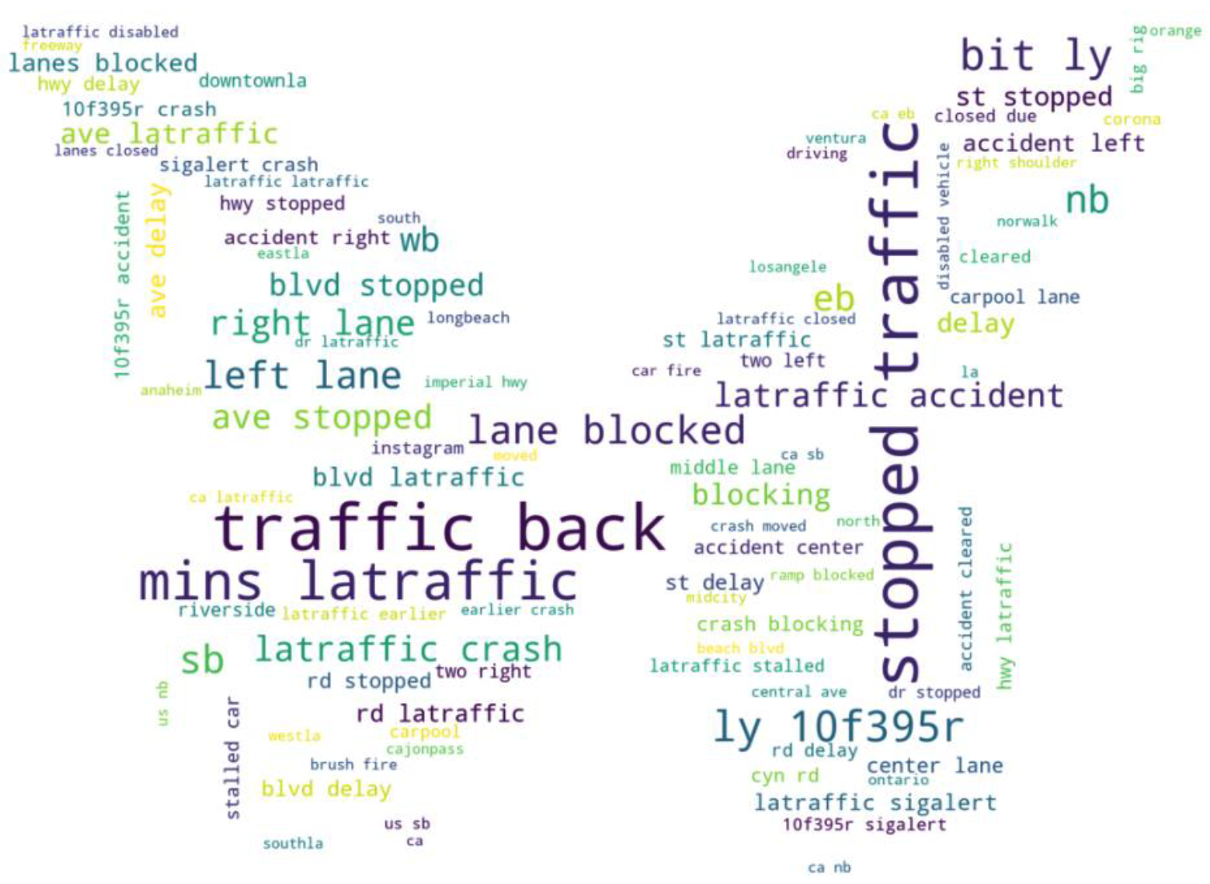
Traffic Collision Analysis
Description
As the second largest in the United States, Los Angeles has traffic challenges due to a large and growing population and an increase in the number of cars. A better understanding of the factors that contribute to accidents can help government officials, companies, citizens, and other interested parties to understand how to make the city safer and more drivable.
The goal is to explore the trends and correlations between the data to provide useful information that can help answer our proposed analysis questions:
What are the most dangerous intersections?
What are the most common collision areas in Los Angeles?
What are the best/worst times of the day for accidents? Best/worst month?
What is the demographic makeup of victims in collisions?
What is the relationship between income and collision victims?
Do certain temperatures or weather play a factor?
Technology
Python
Source Code
https://github.com/sathish-rajendiran/ist652/tree/main/Project/Final_Submission

Slide 14
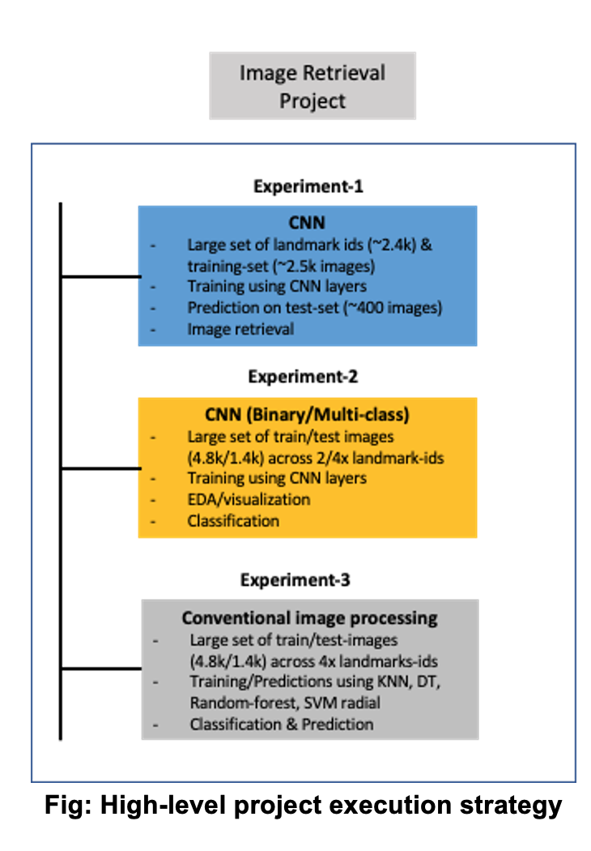
Computer Vision on Google Landmarks Data
Description
The project team has chosen the data set that comes from the interesting Kaggle competition “Image retrieval using Google Landmarks data”. The objective was to predict the images correctly by labels, using deep learning techniques (convolutional neural networks) and to compare the results with traditional models, such as Decision tree, k-Nearest Neighbors, Support Vector Machines and Random Forest. In addition, the team investigated the configuration of the architecture of convolutional neural networks (CNNs) and explored hyperparameter-tuning for model-fitting to determine whether CNNs are better than traditional classification algorithms for an image classification task.
Technology
R & Weka
Learnings
Data mining tasks
Classification, Clustering and Association rule mining
Description vs Prediction
Correlation vs Causation
Data Transformation
Sampling methods
Association rule
Support, Confidence and Lift
Apriori principle
Clustering
Partitional vs Hierarchical
Distance measures
Model evaluation
Overfitting, Hold-out, cross validation
Precision, recall & F-measure
Speed, robustness, scalability & Interpretability
Bayes theorem
Conditional vs joint probabilities
Naïve Bayes classifier
k-Nearest Neighbor
Support vector machines
Source Code
https://github.com/sathish-rajendiran/ist707/tree/main/Final_Project

Slide 15
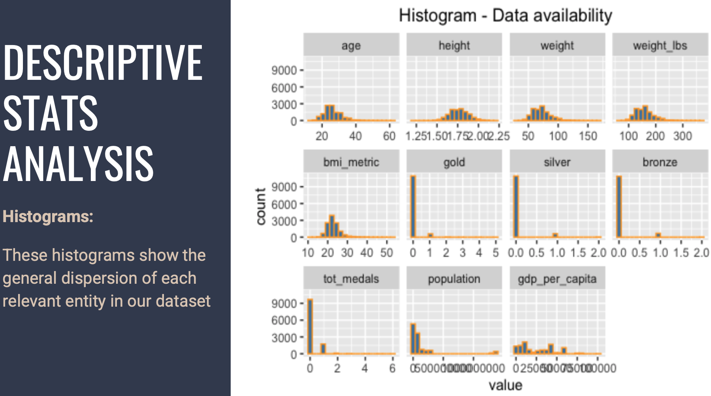
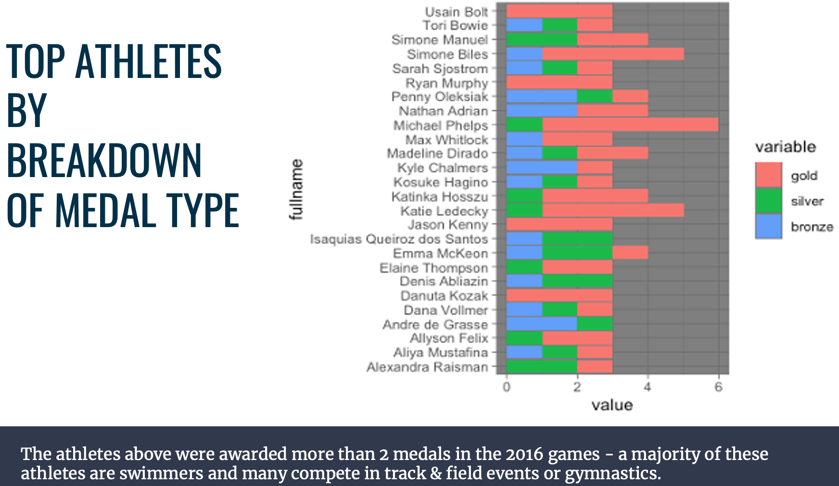
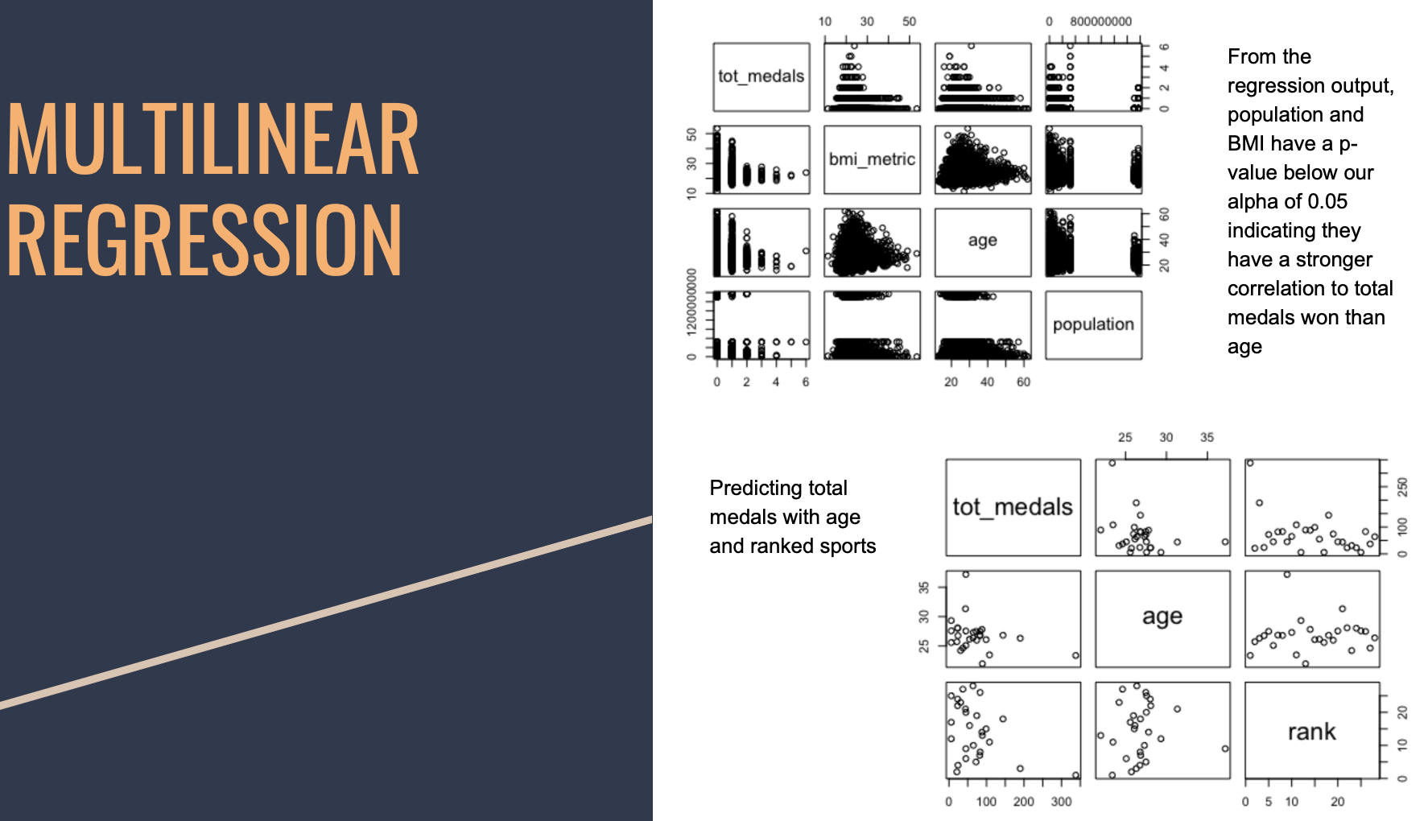
Predicting Athletes Sponsorship
Description
Predicting Athlete sponsorship with 2016 Rio Olympic games data
Does an athlete’s estimated BMI affect their chances of winning a medal?
Is there a relationship between country and number of medals won?
Which athletes are most likely to be sponsored?
Technology
R
Source Code
https://github.com/sathish-rajendiran/ist687/tree/main/Final_Project

Slide 16
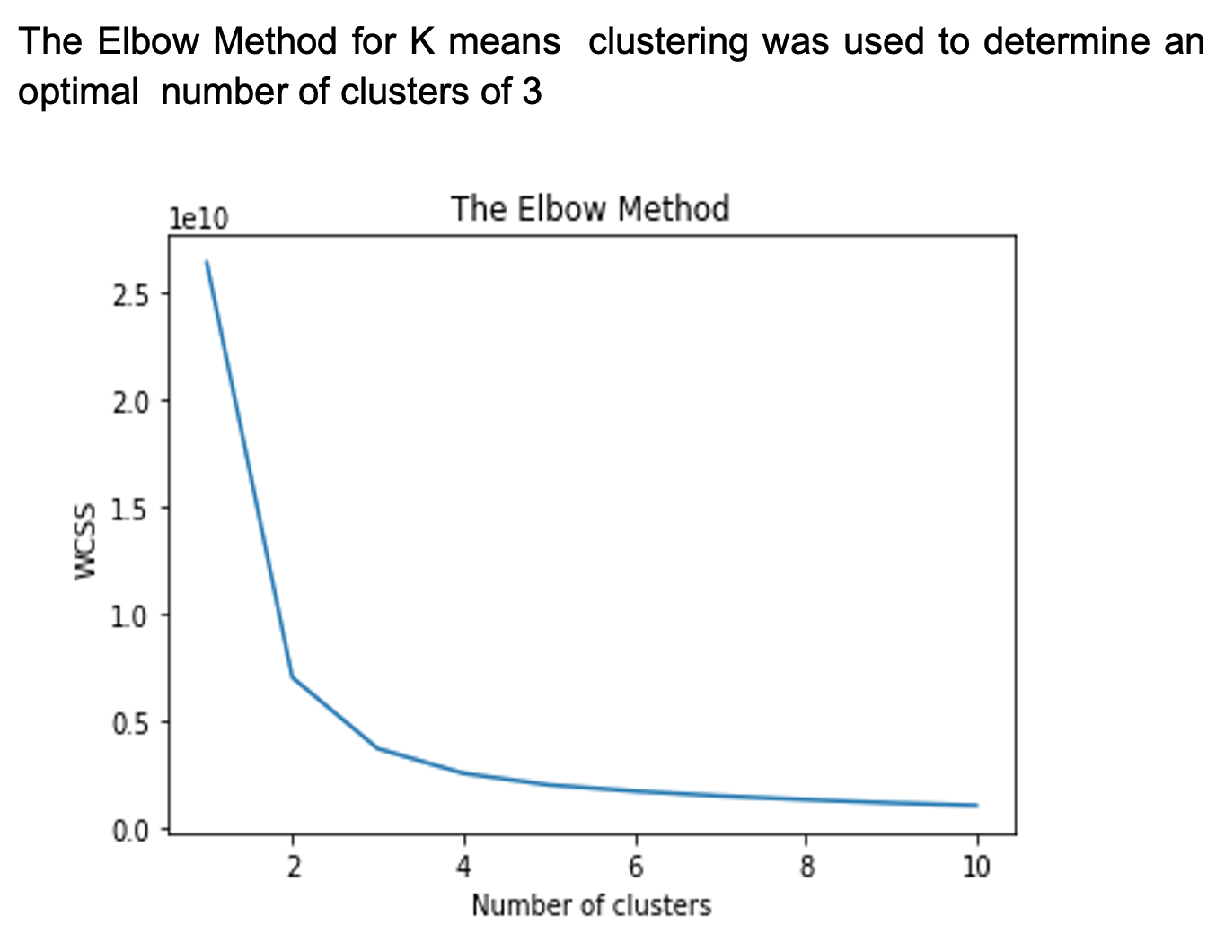
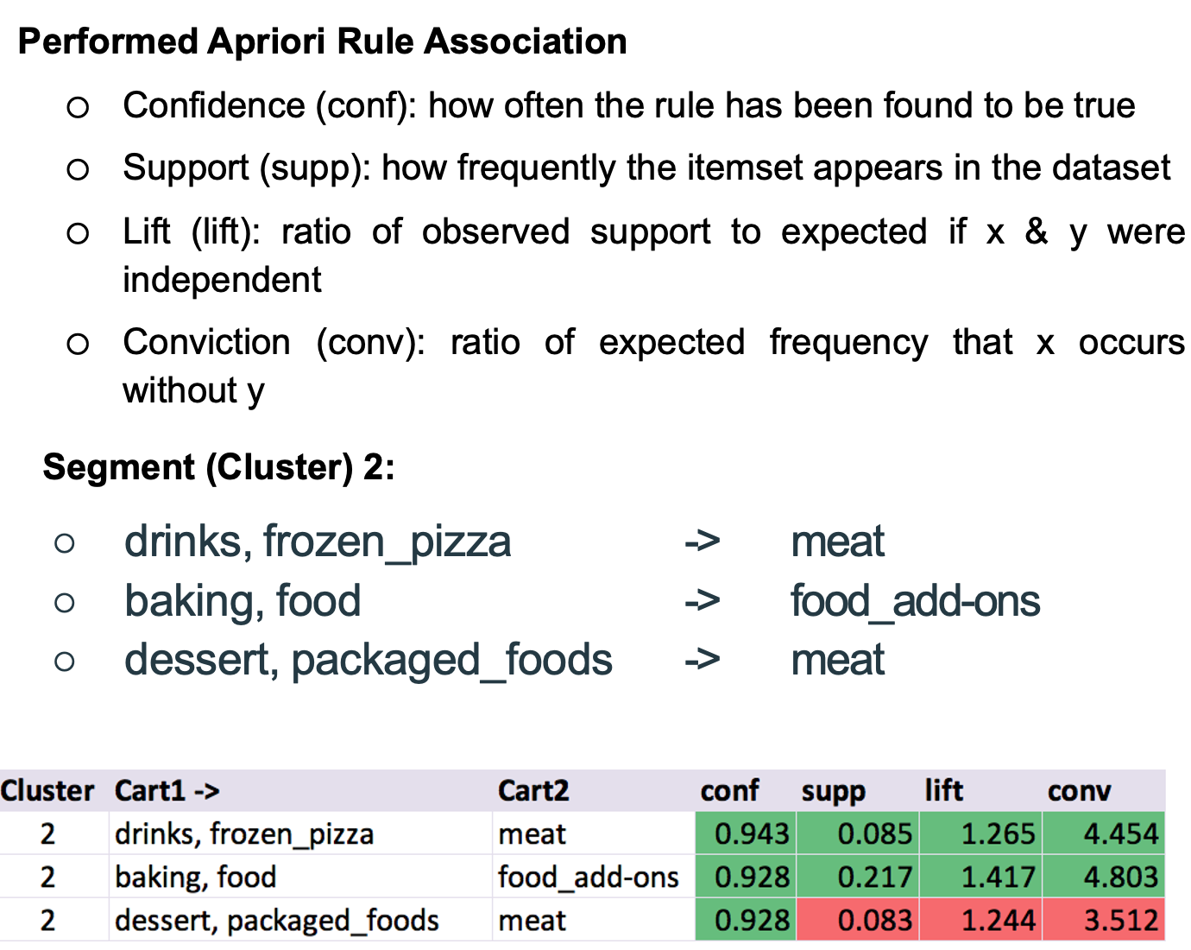
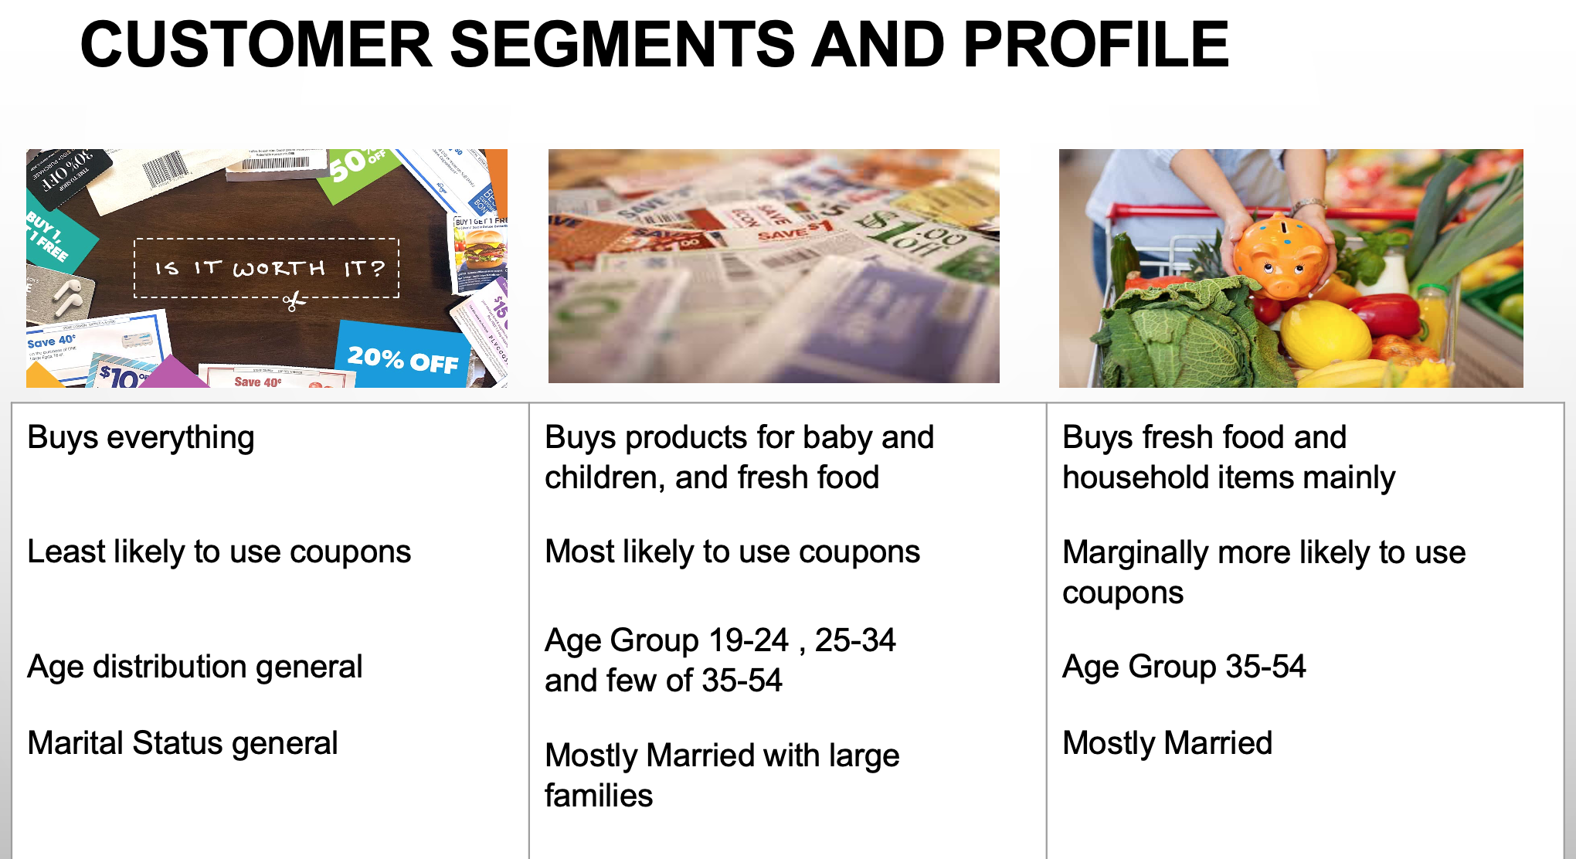
Market Basket Analysis
Description
Given our customer base of roughly 2,500 households with ~45,000 transactions over 2 years of shopping at a retailer, our goal is to segment and profile our customers based on factors such as income, shopping behavior, and demographics; then use this data to identify frequently paired items to develop a direct mail coupon campaign
Who are potential coupon users?
What's the relationship between price, quantity, and coupon value?
Which are the most frequent items sold?
What's the optimal coupon value for selected most frequent items?
Technology
Python
Source Code
https://github.com/sathish-rajendiran/mar653/tree/main/Project/Final_Submission

Slide 17
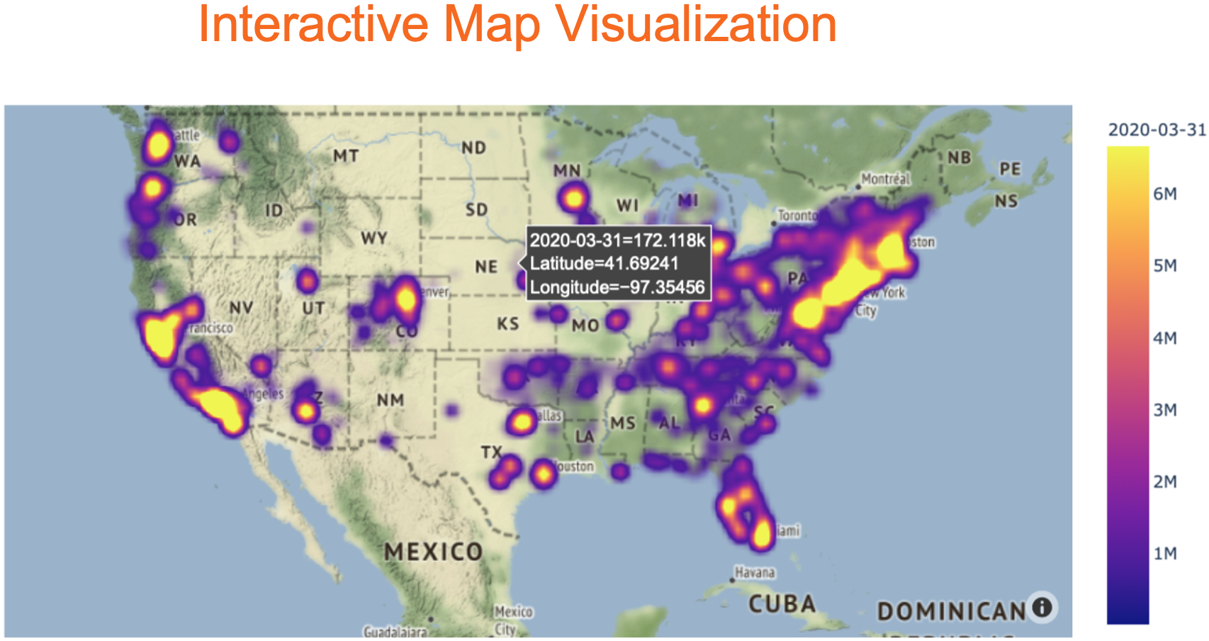
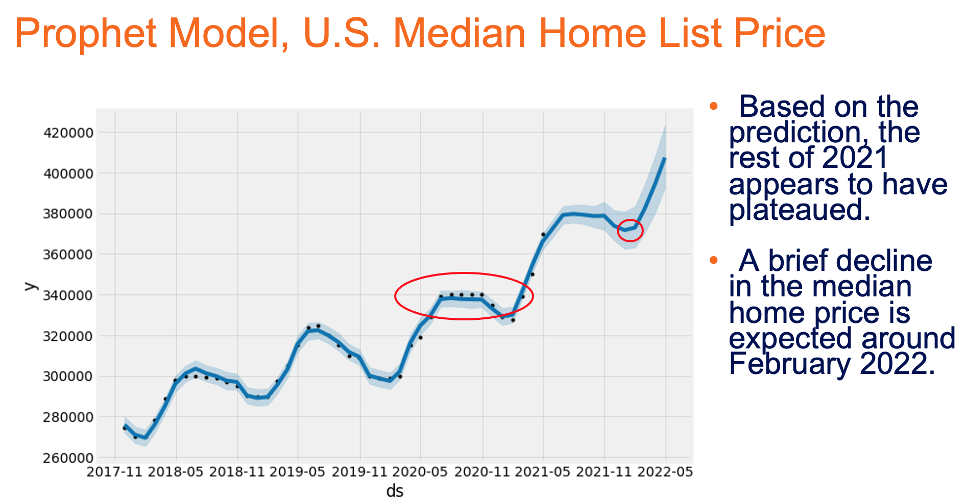
Zillow Pricing Analysis
The Problem
Due to COVID-19 changing social and professional constructs, people have been in a frenzy to buy homes (having saved money from inability to go outside or participate in events). From the news, online publications, and personal experiences, we can see that this has had a significant impact on the overall housing market, from both the buyer’s perspective and the seller’s perspective.
Hypothesis
Buyers who are financially capable of purchasing a home, will be more likely to get the lowest interest rates for next few years than those who do not purchase now. However, buyers will experience highest home prices and severe supply & demand shock due to COVID-19.
Sellers who can sell their home between March 2020 – EOY 2021 will be more likely to retrieve the highest home sale price for the next few years than those who do not sell now.
Observation
Home Inventories have reached their lowest point in the last 3 years
Home Median List Prices have reached their highest point in the last 3 years
Home Values have reached their highest point in the last 24 years
Employment to Population Ratio reached lowest point in the last 20 years
Unemployment Rate reached highest point in the last 20 years
15YR and 30YR Fixed Mortgage Rates reached lowest point in 20 years
Modeling techniques used:
Autocorrelation, Partial Autocorrelation
SARIMAX models focusing on CA, NC, and VA
Auto ARIMA & Grid Search Framework
Prophet (Entire U.S.)
Based on our observation and analysis, we would recommend the following:
Should buyers purchase now?
Should sellers list now?
Technology
Python
Source Code
https://github.com/sathish-rajendiran/ist718/tree/main/Final_Project

Slide 18
Summary
Overall, this program has made me to look at data problems more efficiently. In addition,
Effective storytelling
Building data pipelines using R & Python languages.
Processing tweets, clickstream and social network data using NoSQL technologies
Process improvements using DMAIC principles (L & A)
Data Analytics, Text Mining, Machine Learning, Statistic Modeling, Predictive, Prescriptive Modeling and Natural Language Processing (NLP)
Hands-on experience on Python libraries like NumPy, Pandas, Matplotlib, Seaborn, NLTK, Sci-kit learning, SciPy, TensorFlow, Keras & PyTorch
Experience in Text Analytics, developing different Statistical Machine Learning, Deep Learning, Data Mining solutions to various business problems and generating data visualizations using R, Python and creating dashboards using tools like Tableau & Qlikview
Natural Language Understanding (Sentiment Analysis, Custom Analyzers, Entity Analysis, Word embedding)
Natural Language Processing-NLP (LSA, LDA, TF-IDF, Markov Models, Tokenizers, Analyzers, POS tagging)
Unsupervised techniques (PCA, K-Means and Hierarchical Clustering)
Dimensionality reduction techniques (PCA)
Non-Parametric Fast Learning ML Algorithms (Decision Trees, Random Forest, Gradient Boosting (Xgboost, Light Gradient Boosting), SVM)
Deep Learning Models (Neural Network: CNN, RNN), Deep Learning Frameworks (Tensor Flow, Keras)
Big Data platforms such us
Hadoop (HDFS, MapReduce, YARN, Pig, Hive, Hbase, Impala
MongoDB, Redis, Cassandra, Kafka and KSQL
Next Steps
Advanced Research/enrolling in PhD program
Participating in Kaggle Competitions
Student Ambassador - Helping prospects and students to excel in this program

Slide 19
References (Textbook and Readings)
Discovering Statistics by Daniel T. Larose - 3rd edition
Understanding Variation - The Key to Managing Chaos, 2nd edition By Donald J. Wheeler; SPC Press
Hoffer, J. A, Ramesh, V., & Topi, H. (2016). Modern database management (12th ed.). New York, NY: Pearson.
Managerial Analytics: An Applied Guide to Principles, Methods, Tools, and Best Practices, December 2013, 1st Edition, Watson, and Nelson
A Practitioner’s Guide to Business Analytics: Using Data Analysis Tools to Improve Your Organization’s Decision Making and Strategy, 2013, Bartlett
Introduction to Data Science (2017), by Jeffrey S. Saltz & Jeffrey M. Stanton.
Pang-Ning Tan, Michael Steinbach, and Vipin Kumar (2005) Introduction to Data Mining.
Tom Mitchell (1997) Machine Learning
Brett Lantz (2015) Machine Learning with R (second edition).
Stanton (2017), Reasoning with Data: An Introduction to Traditional and Bayesian Statistics Using R
Bird, S., Klein, E., & Loper, E. Natural language processing with Python
Jurafsky, D., & Martin, J. H. Speech, and language processing (3rd ed. draft).
Pang-Ning Tan, Michael Steinbach, and Vipin Kumar (2005) Introduction to Data Mining
Venkatesan, R., Farris, P. and Wilcox, R. (2019). Cutting Edge Marketing Analytics: Real World Cases and Data Sets for Hands on Learning
Yau, N. (2011). Visualize this: The Flowing Data guide to design, visualization, and statistics. Wiley Publishing.
Yau, N. (2013). Data points: Visualization that means something. Wiley Publishing.
A Smarter Way to Learn Python by Mark Myers (available on Amazon)
Python for Everybody: https://www.py4e.com/book (Python version)
Miller, Thomas W., Modeling Techniques in Predictive Analytics with Python and R, Pearson, 2015.
Goodfellow, Ian, Yoshua Bengio, and Aaron Courville, Deep Learning (DL), MIT Press, 2016
James, Gareth, Daniela Witten, Trevor Hastie, and Robert Tibshirani, An Introduction to Statistical Learning with Applications in R, Springer, 2013
Source Repository
https://github.com/sathish-rajendiran?tab=repositories
Resume
https://www.linkedin.com/in/sathish-kumar-rajendiran-2963599/

Slide 20


